Slide 1
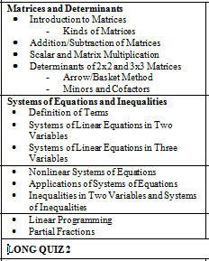
SECTION 10.1

Slide 2
Matrices

Slide 3
Introduction to Matrices

Slide 4
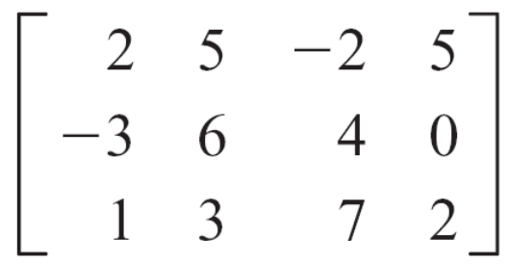
Introduction to Matrices
A matrix is a rectangular array of numbers. Each number in a matrix is called an element of the matrix.
The matrix below, with three rows and four columns, is called a 3 × 4 (read “3 by 4”) matrix.
A matrix of m rows and n columns is said to be of order
m × n or dimension m × n.

Slide 5
Introduction to Matrices
A square matrix of order n is a matrix with n rows and n columns.
The matrix has order 3 × 4. We will use the notation a_{ij} to refer to the element of a matrix in the i th row and j th column.
For the given matrix, a₂₃ = 4, a₃₁ = 1, and a₁₃ = –2.
The elements a₁₁, a₂₂, a₃₃,…, a_{mm} form the main diagonal of a matrix. The elements 2, 6, and 7 form the main diagonal of the matrix.

Slide 6

Introduction to Matrices
A matrix can be created from a system of linear equations.
Consider the system of linear equations
2x – 3y + z = 2
x – 3z = 4
4x – y + 4z = 3

Slide 7
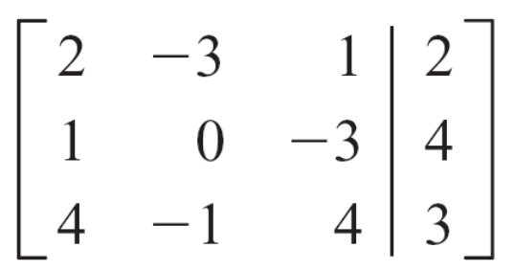
Introduction to Matrices
Using only the coefficients and constants of this system, we can write the 3 × 4 matrix
This matrix is called the augmented matrix of the system of equations.

Slide 8
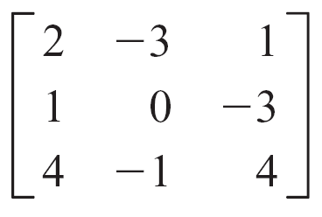
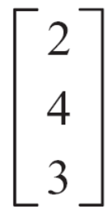
Introduction to Matrices
The matrix formed by the coefficients of the system is the
coefficient matrix. The matrix formed from the constants
is the constant matrix for the system.
The coefficient matrix and constant matrix for the given
system are
Coefficient matrix:
Constant matrix:

Slide 9
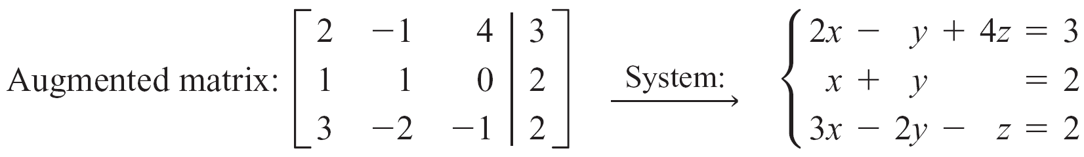
Introduction to Matrices
We can write a system of equations from an augmented matrix.

Slide 10
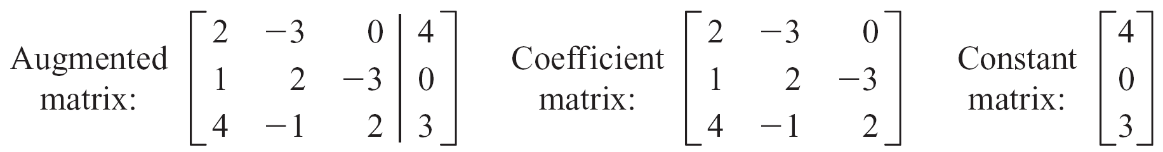
Example 1 – Write the Augmented Matrix from a System of Equations
Write the augmented matrix, the coefficient matrix, and the constant matrix for the following system of equations.
2x – 3y = 4
x + 2y – 3z = 0
4x – y + 2z = 3
Solution:

Slide 11
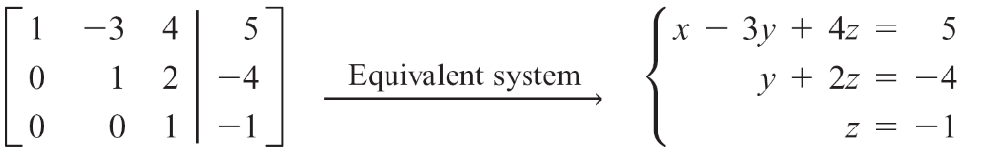
Introduction to Matrices
In certain cases, an augmented matrix represents a system of equations that we can solve by back substitution.
Consider the following augmented matrix and the equivalent system of equations.
Solving this system by using back substitution, we find that the solution is (3, –2, –1). The matrix above is in row echelon form.

